Slide 1
Digital Circuit Diagram Recognition
James Brown, Eric Doi,
Emily Fujimoto, Marty Field
Christine Alvarado

Slide 2
Introduction
Sketching is a natural way to represent many types of data, including circuit diagrams
Computers offer editing and simulation abilities that paper and whiteboards can’t match.

Slide 3
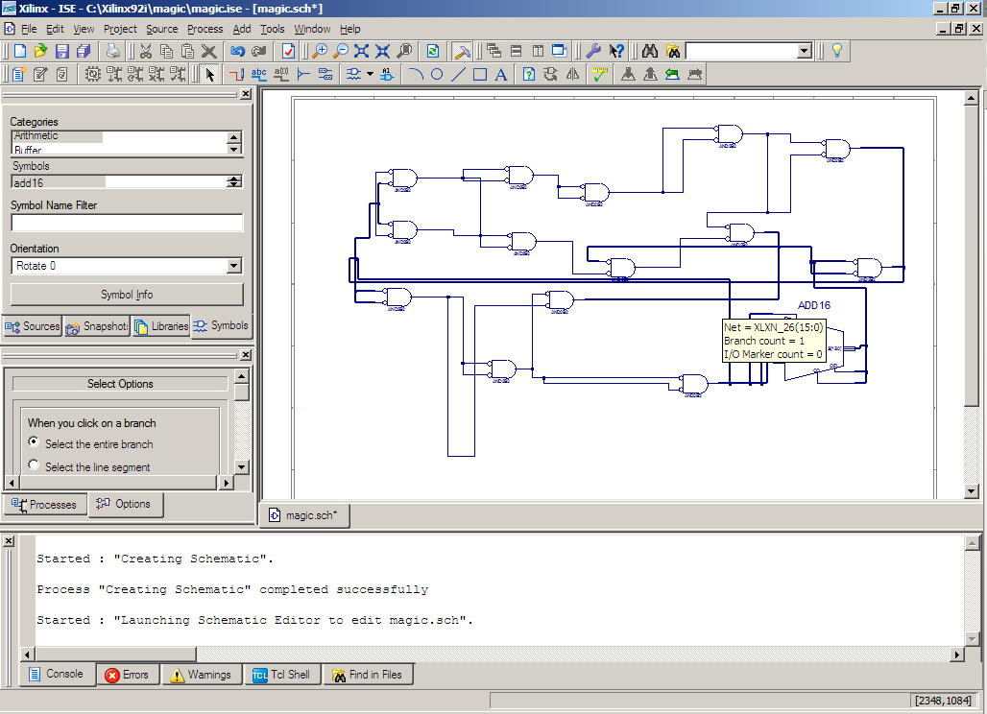
Motivation
“The hardest part of E85 was wrestling with Xilinx” ^{{citation needed}}
Combine the ease-of-use and natural feel of paper with the power of a computer interface.

Slide 4
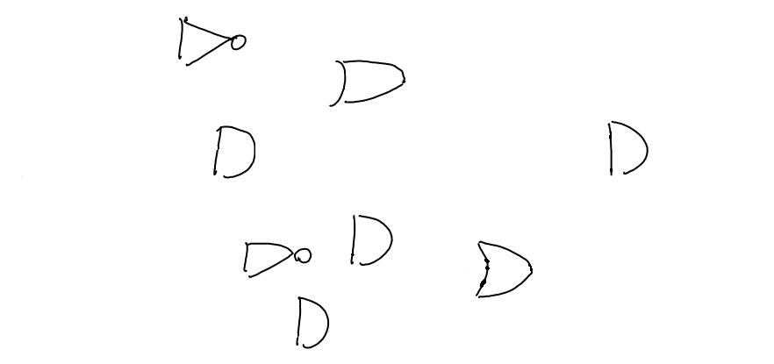
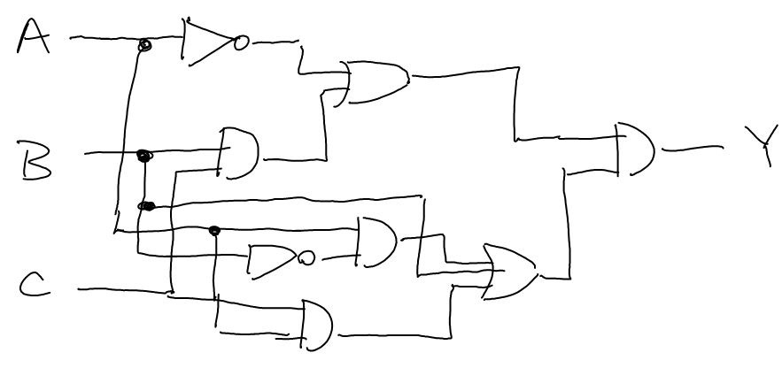
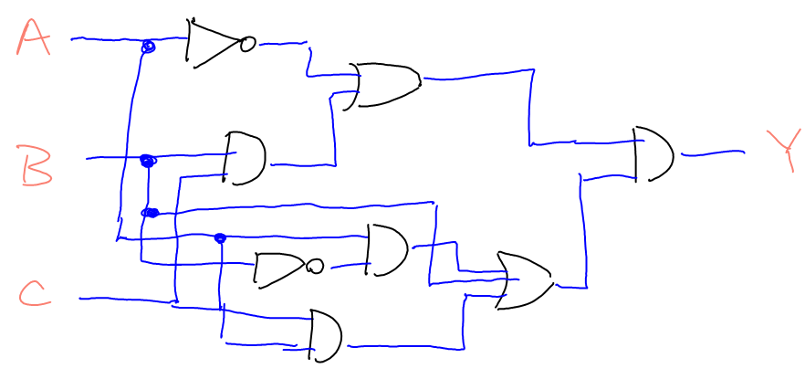
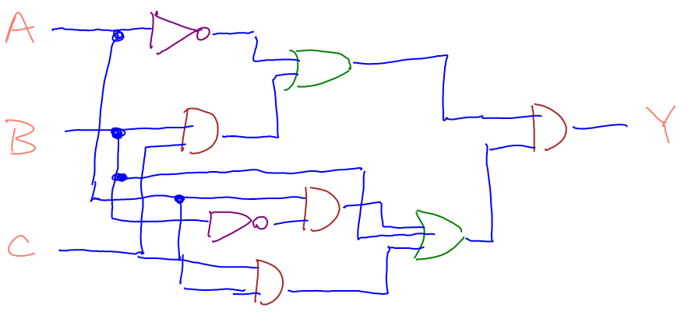
Recognition Overview
Notes:
Here, we have an unlabeled sketch.
First, we apply labels of “wire”, “gate”, or “label” to each stroke in the sketch.

Slide 5



The Importance of Context
A wire?
A gate?
What is this?
A label?
Notes:
A conditional random field provides a good way to account for context.

Slide 6
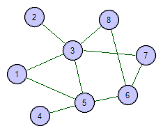
Conditional Random Fields
A graphical model used to find the conditional probability P(y|x), where x is a set of input data and y is a set of labels. Consists of:
A graph
Two types of “potential” functions
Site
e.g., site(wire) = 17.3
Interaction
e.g., interaction(wire, gate) = 128.7
P(y|x) can be factored into a weighted product of these potential functions, normalized to a value between 0 and 1.

Slide 7
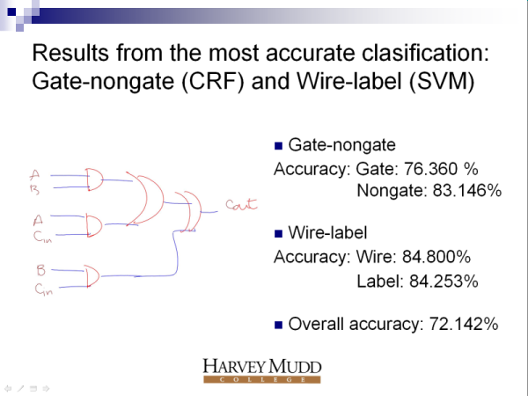
Progress
A slide from last summer’s work
Notes:
Last summer some progress was made by using a combined approach with a CRF and a Support Vector Machine.

Slide 8
Results from one of the most accurate classifications: Wire-gate-label (CRF)
Accuracy: 100%
Notes:
Does this sketch look familiar? This was an actual sketch that was processed correctly by just our CRF. We made a good amount of progress this summer with the CRF by changing the inference algorithm we used—last summer, we had been using approximations for speed. Suspecting that this was limiting our performance, we implemented what’s called the junction tree algorithm, which calculates the marginal probabilities of the CRF exactly. To put it very briefly, the problem with the approximation algorithm was when it encountered cyclic dependencies. The junction tree algorithm handles cycles by tweaking the graph to find the underlying interdependencies and grouping together connected components. This has improved our three-way classification accuracy to over 90%. We’ve been able to keep the classification at a reasonable speed by making other optimizations and improvements. Now, I should mention that the approximations aren’t really so terrible; the problem was complicated by the fact that we were using the approximations for the training. If we use the junction tree algorithm to train the CRF parameters and then run approximation inference on that, it’s better, but still not as good as with the junction tree algorithm.

Slide 9
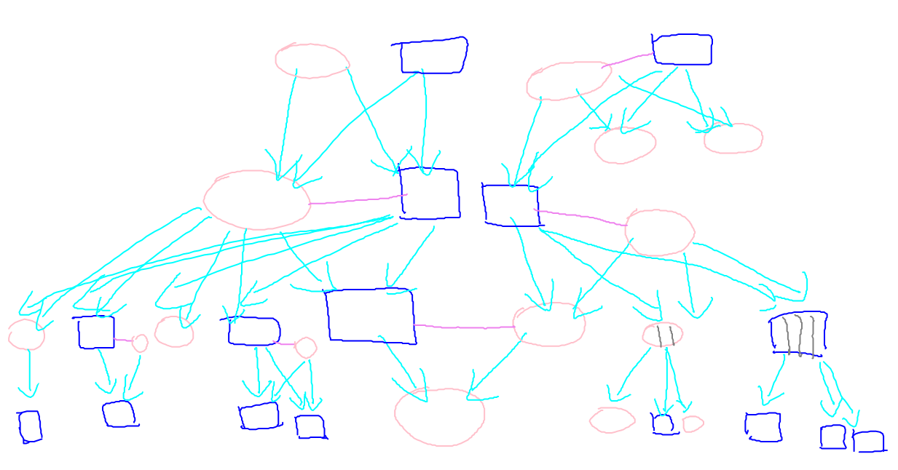
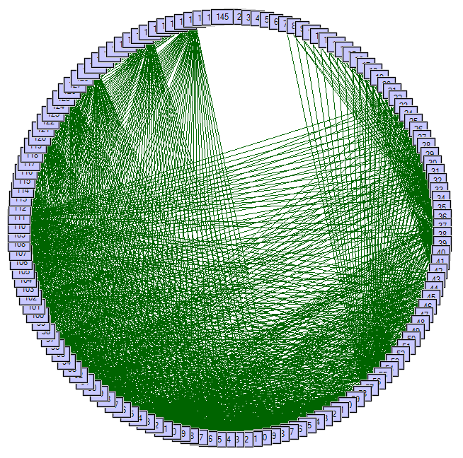
Problems
Notes:
However, the junction tree algorithm does have problems if the graph becomes too complicated.
Family tree has max clique of 30. Junction tree algorithm has exponential complexity with respect to the maximum clique size, and 15 is pushing the limits.
Work remains to be done to see if there is a better way to make stroke connections to simplify the graphs while maintaining a reasonable classification accuracy.

Slide 10
Trade-Offs
What We Want
  High accuracy
  Low time requirement
  Low data requirement
Problem
  More data = Higher accuracy, but longer training time
Where’s a good balance?

Slide 11
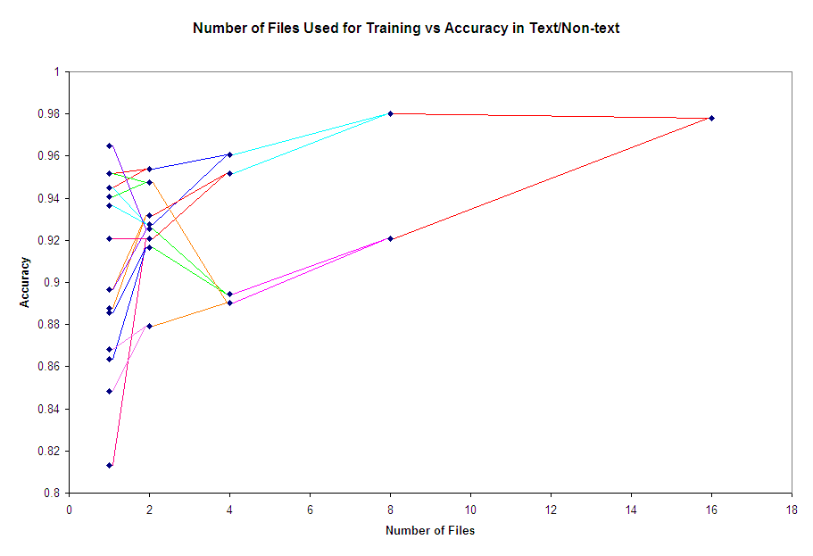

Slide 12
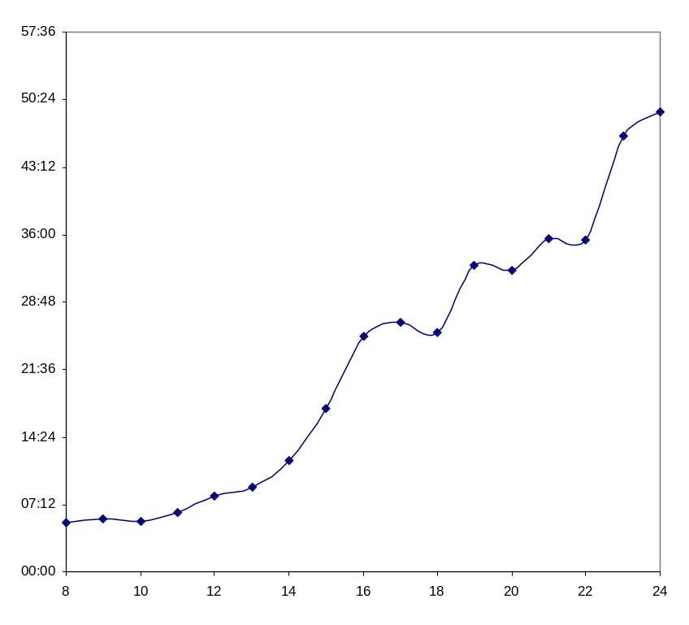
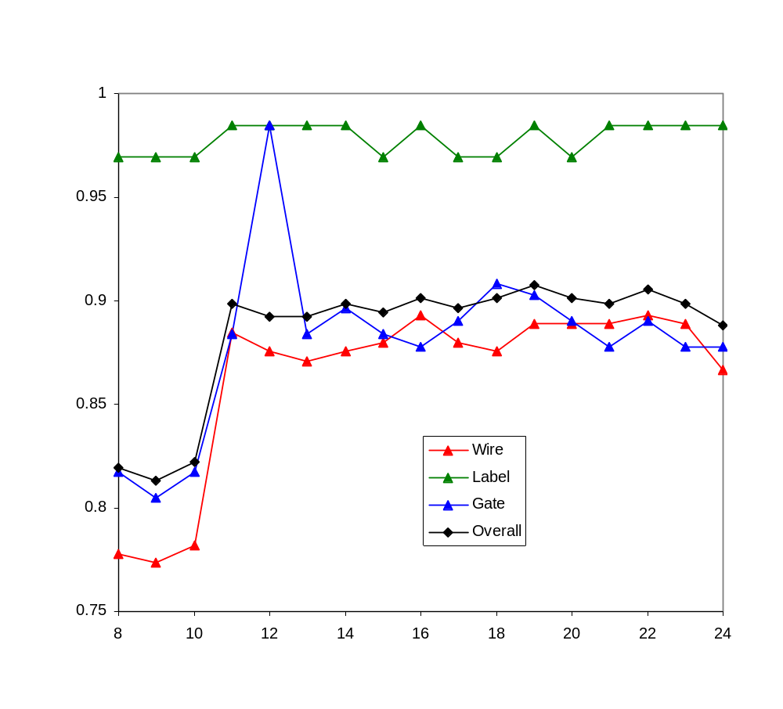
Time
(mm:ss)
Accuracy
Number of Files Used in Training

Slide 13
Symbol Recognition
Once we’ve isolated the gates, we need to determine what they are (e.g., “AND”, “OR”, “NOT”)
Different approaches:
  Feature-based
  Image-based

Slide 14
Symbol Recognition: Congealer
Image-based symbol recognizer
Performs image alignment by a constrained search of affine transforms (“congealing”)
Uses a custom image metric to perform classification on the aligned images
Training
Brute-force rotation search for pre-alignment
Classification
Metrics: Yule, Tanimoto, Hausdorff, Modified Hausdorff

Slide 15




Symbol Recognition: Congealer
Congealing Example
Notes:
Talk about pre-alignment and affine transform search

Slide 16
Symbol Recognition:
Congealer Results
 | and | bubble | nand | nor | not | or | xor | Recognition
and | 10116 | 1015 | 109 | 32 | 1225 | 909 | 0 | 75.46%
bubble | 281 | 256 | 0 | 0 | 205 | 0 | 0 | 34.50%
nand | 493 | 0 | 4236 | 310 | 4732 | 61 | 0 | 43.08%
nor | 377 | 0 | 727 | 5244 | 2561 | 741 | 0 | 54.34%
not | 0 | 0 | 144 | 59 | 12230 | 23 | 0 | 98.19%
or | 1178 | 308 | 0 | 691 | 1277 | 6852 | 1210 | 59.50%
xor | 381 | 622 | 81 | 211 | 938 | 816 | 7195 | 70.24%
Precision | 78.87% | 11.63% | 79.97% | 80.10% | 52.79% | 72.88% | 85.60%
 |  |  |  |  |  | Total Accuracy |  | 67.99%
Notes:
Highlights: 98% on NOT gates, with over 12000 examples being classified
Lowlights: Only 34.5% on bubbles

Slide 17

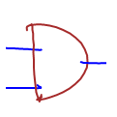

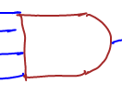
Symbol Recognition:
Congealer Problems
Highly variable sketching styles:
Computationally intensive:
  Recognition takes between two and ten seconds for each gate.
  Training takes upwards of 40 CPU-hours
Notes:
This is a selection of AND gates taken from our data.
Note: easily parallelizable to 8-threads; already coded to support threading

Slide 18


Symbol Recognition:
As Gestures
Symbol
Gesture
one or many strokes
order and direction
  unimportant to meaning
one stroke only
direction important to meaning
Notes:
Introduction to Symbols vs. Gestures:
Symbol: final shape important
Gesture: act of drawing important
The reason we want to do this is considering gates as gestures encodes information about how the user drew the gate.

Slide 19
Sketching Style Study
It is easy to collect data by asking users to draw a specific shape.
Is it safe to use this data to train a recognizer?
  What if users draw differently if they have to think about what they’re drawing?
Gestures place emphasis on being drawn the same every time.
Notes:
Motivation for the study

Slide 20
Sketching Style Study
Use gesture recognizers to determine similarity of shapes between drawing tasks.
  Copy task
    Isolated gates
    Entire circuits
  Synthesis task
    Given logical expression, create a circuit
High recognition accuracy comes from consistent drawing styles.
Notes:
Layout of the study:
-train on one activity, test on another
-compare to training and testing on same
-all pairwise combinations
The goal:
-if we can get high recognition accuracy across tasks, then the gates were drawn consistently.

Slide 21
The $1 Gesture Recognizer
0
1
2
3b
3a
Notes:
How do you recognize a gesture?
1991 paper by Dean Rubine: 13 features, complex matrix operations.
2007 paper by Wobbrock, Wilson, and Li presents an extremely effective solution in about 100 lines of code. Outperforms Rubine. Easy to add training examples incrementally.
Step 1: resample
Step 2: rotate, center, scale
Step 3: (for classification) rotation search
Step 3b: (for classification) point-to-point distance

Slide 22
Adding my thoughts to create $1.02
Resample: points per shape
Skip initial rotation
Ignore point order

Slide 23

How do we match the points?
O(N!)
Hausdorff Distance
Greedy
Exact Solution
Notes:
Bad matching algorithms:
Hausdorff: not 1-1
Greedy: make really poor choices based on order
Optimal: would take forever

Slide 24
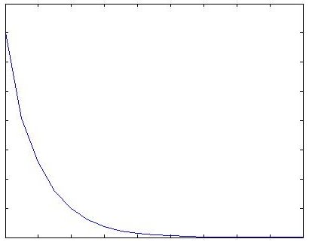

How do we match the points?
Simulated Annealing
current state
random neighbor
dist. = 9
dist. = 10
dist. = 10
dist = 3
decision function
temp
current_dist
neighbor_dist
current_temp
Accept
Reject
time
Notes:
Simulated annealing simulates molecules aligning as a piece of metal cools. When the temperature is high, a wide range of movement is possible.
Parameters:
Initial temperature and cooling function: We used an exponential decay so that it doesn’t have a long time to get off track at the beginning.
Decision function: Takes as parameters the current state distance, the neighbor state’s distance, and the current temp and decides with a random factor if the neighbor state should become the current state.
Initialize current state to the greedy solution.
Generate a neighbor by swapping any pair of points’ matches.
Rinse, repeat.

Slide 25
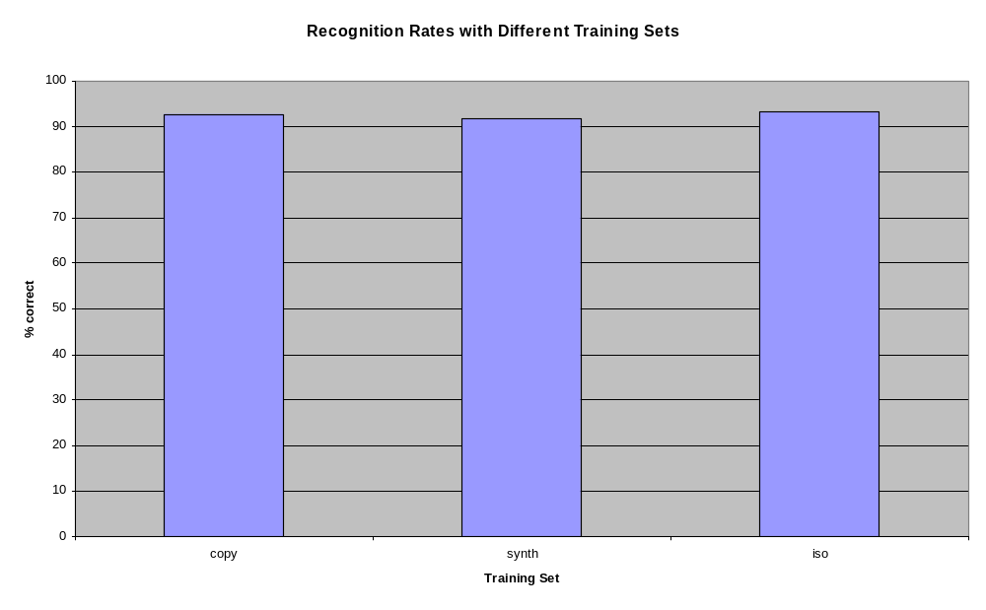
Sketching Style Survey Results
Notes:
The training set used did not have a significant impact on the recognition rates.

Slide 26
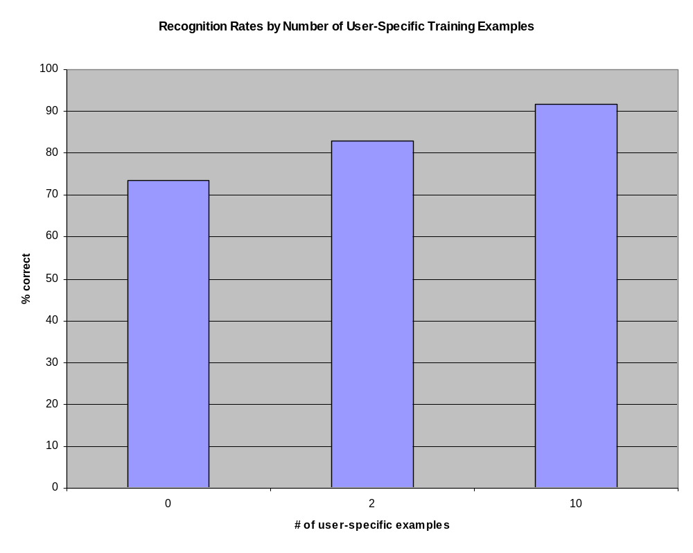
The Effect of User-Specific Training Examples
Notes:
# of user specific training examples did have a significant effect.
Furthermore, evidence indicates that user-specific training examples should replace global training examples as they can be collected.

Slide 27
Future Work
Examine alternate feature-sets for the CRF
Integrate multiple recognizers

